Slide 1
Data Science Program

Slide 2

Course: DataScience
Data Science: Introduction Session
Instructor : Ved Prakash
Linkedin : https://www.linkedin.com/in/thevedprakash/
www.rapidminer.com
Free Download

Slide 3
Agenda
Understanding the Audience
Syllabus under the Program
Data Science and related Terminologies
Tools of Trade
Questions

Slide 4
Understanding the Audience

Slide 5
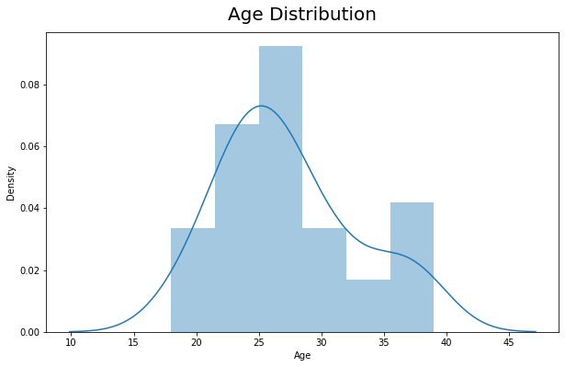
Understanding Audience
Here are some quick Stats pulled from Survey for the Batch.
Age:
Learner’s joining us comes from diverse age ranging from
18 yrs - 39 yrs.
Most of the people fall in range 20 -30 yrs

Slide 6
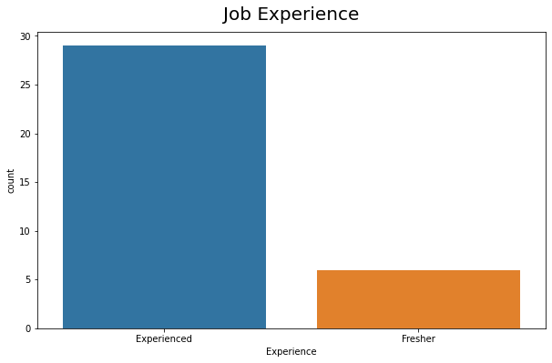
Understanding Audience
Experience:
Experienced : 82.85 %
Fresher : 17.14 %

Slide 7
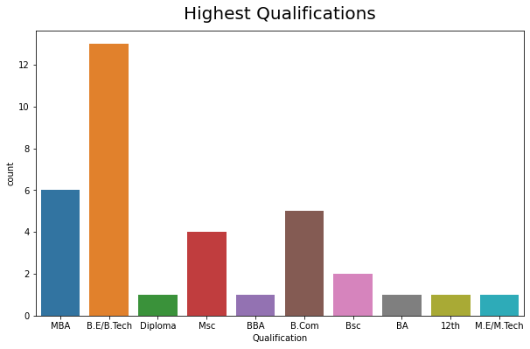
Understanding Audience
Highest Qualification:
B.E/B.Tech 37.14 %
MBA 17.14 %
B.Com 14.28 %
Msc 11.42 %
Bsc 5.71 %
12th 2.85 %
BBA 2.85 %
M.E/M.Tech 2.85 %
Diploma 2.85 %
BA 2.85 %

Slide 8
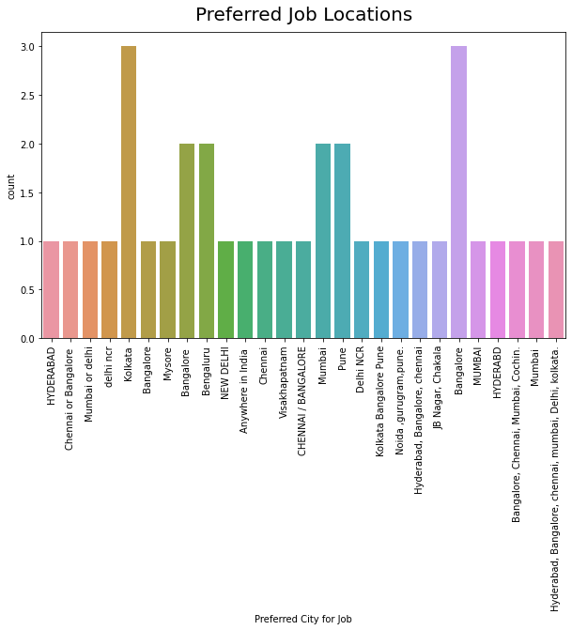
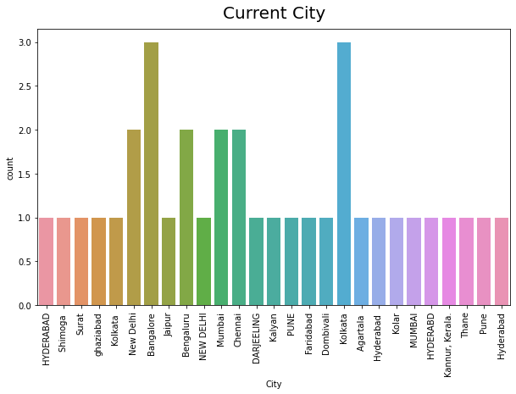
Understanding Audience
Current City:
Learner’s are joining in across from India
Preferred City for Jobs:
Some have very specific locations in mind other are open across multiple location.

Slide 9

Understanding Audience
From the Stats pulled from Survey for the Batch here are some deductions.
Hypothesis:
Learner’s are trying to upskill themselves to get better opportunities in current
role.
Learner’s are to switch into another role or organization.
Learner’s are trying to acquaint themselves trending technology stack.
More to Add.
...

Slide 10

Question
What option you can associate yourself most in respect of joining Data Science Program?
A) Trying to upskill themselves to get better opportunities in current role.
B) Transition into another role or organization.
C) Trying to acquaint themselves trending technology stack.
D) Others

Slide 11
Syllabus under the Program

Slide 12
Data Science Program Syllabus
Data Science and Design Thinking Concepts
Analytics
Statistics
Python
Machine Learning
R Programing
SQL ( Structured Query Language)
Tableau

Slide 13
Question
What part of syllabus from Data Science Program interests you most?
A) Statistics/Analytics (Data Analysis)
B) Machine Learning (Building Models)
C) Python/R (Programming Tools)
D) Tableau (BI Tools)
E) SQL (Structured Query Language)

Slide 14
Data Science and related Terminologies

Slide 15

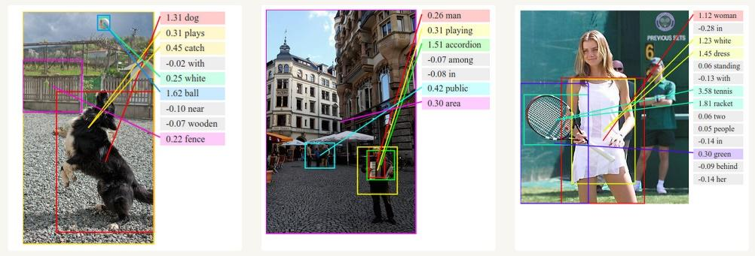

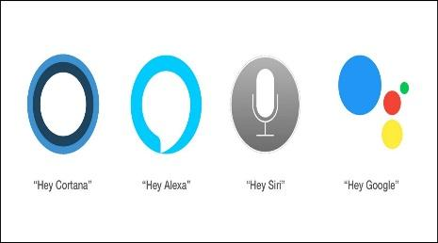


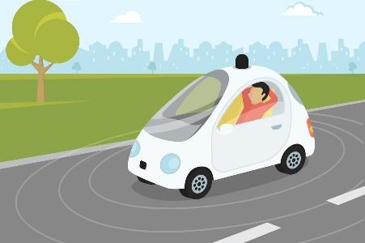

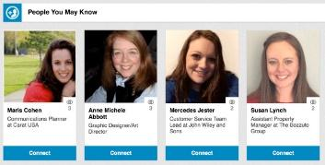
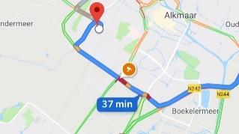
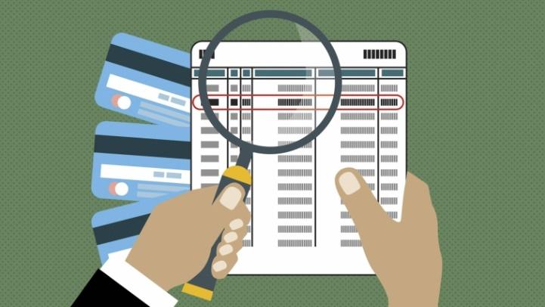

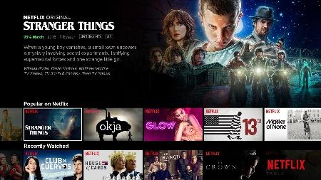
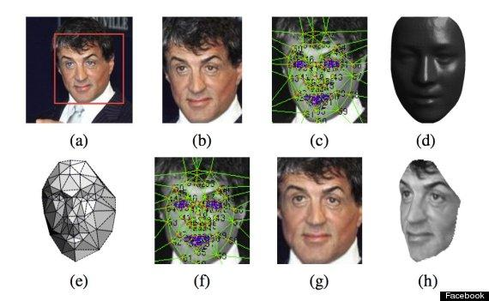

Use Cases

Slide 16
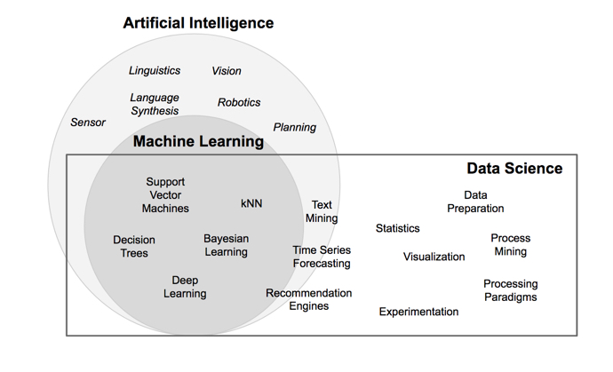
What is Data Science

Slide 17
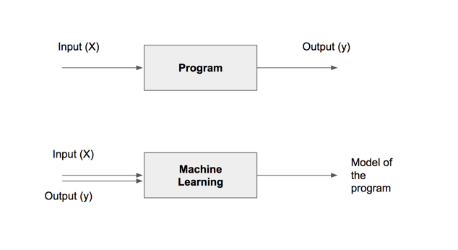
Models

Slide 18
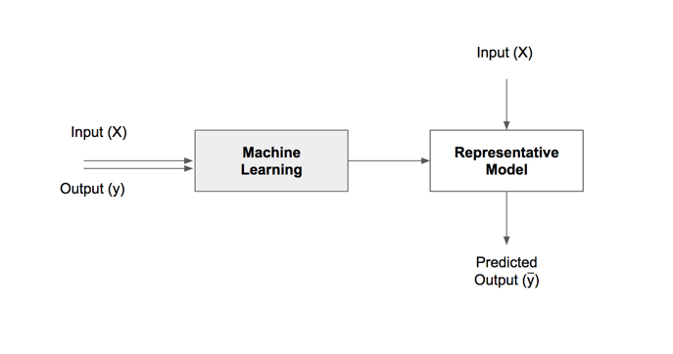
Models

Slide 19
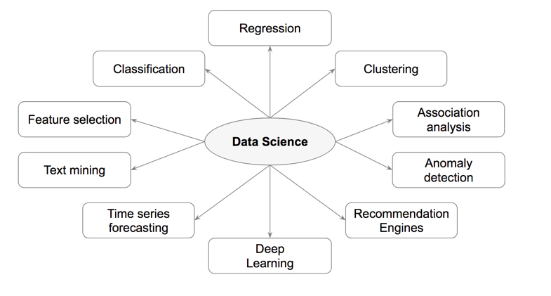
Application of Data Science

Slide 20
Tasks | Description | Algorithms | Examples
Classification | Predict if a data point belongs to one of predefined classes. The prediction will be based on learning from known data set. | Decision Trees, Neural networks, Bayesian models, Induction rules, K nearest neighbors | Assigning voters into known buckets by political parties eg: soccer moms. Bucketing new customers into one of known customer groups.
Regression | Predict the numeric target label of a data point. The prediction will be based on learning from known data set. | Linear regression, Logistic regression | Predicting unemployment rate for next year. Estimating insurance premium.
Anomaly detection | Predict if a data point is an outlier compared to other data points in the data set. | Distance based, Density based, LOF | Fraud transaction detection in credit cards. Network intrusion detection.
Time series | Predict if the value of the target variable for future time frame based on history values. | Exponential smoothing, ARIMA, regression | Sales forecasting, production forecasting, virtually any growth phenomenon that needs to be extrapolated
Clustering | Identify natural clusters within the data set based on inherit properties within the data set. | K means, density based clustering - DBSCAN | Finding customer segments in a company based on transaction, web and customer call data.
Association analysis | Identify relationships within an itemset based on transaction data. | FP Growth, Apriori | Find cross selling opportunities for a retailor based on transaction purchase history.

Slide 21
Process Outline
Core Algorithms
Classification
Decision Trees
Rule Induction
k-Nearest Neighbors
Naïve Bayesian
Artificial Neural Networks
Support Vector Machines
Ensemble Learners
Regression
Linear Regression
Logistic Regression
Association Analysis
Apriori
FP-Growth
Clustering
k-Means
DBSCAN
Self-Organizing Maps
Process Basics
Common Applications
Data Science Process
Data Exploration
Model Evaluation
Text Mining
Time Series Forecasting
Anomaly Detection
Feature Selection

Slide 22
Tools of the Trade

Slide 23
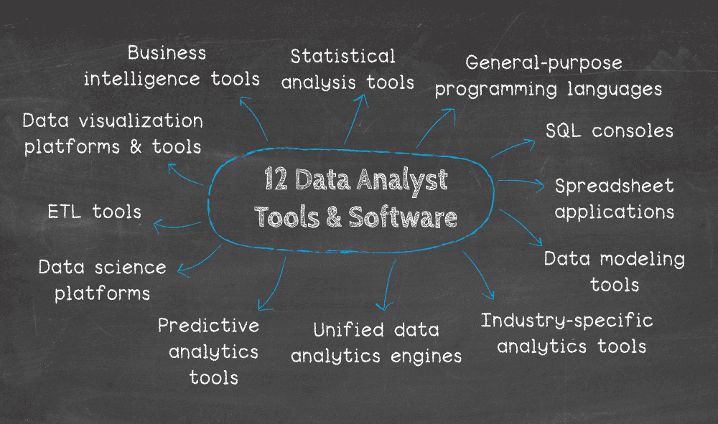
Why do we use Data Tools?

Slide 24









Tools of the trade

Slide 25










Other Tools and resources

Slide 26
Question
What tools you can associate yourself most with?
A) Programming tools( Python, R, Jupyter, Ide Pycharm/Visual Studio Code)
B) BI and Analysis Tools (Tableau, Power BI, qlik sense, Excel, SQL)
C) Version Tools(Github, Bitbucket)
D) Cloud Tools(Aws, Azure, Gcp)
E) None of the above

Slide 27
Questions

Slide 28
Thank You

